Slide 1
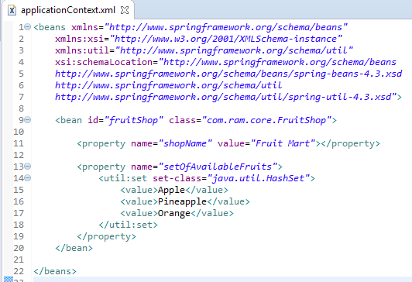
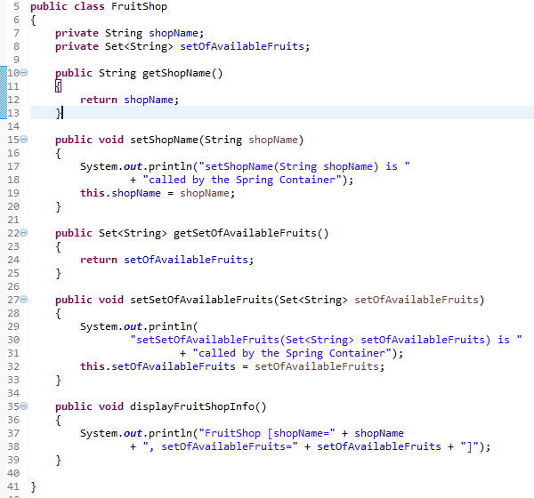
<util:set> to create a concrete Set Collection class (HashSet and TreeSet)
We can use <util:set> to create a concrete Set Collection class (HashSet and TreeSet) in Spring’s bean configuration file.
<util:set> will instantiate an HashSet at runtime, and inject it into a bean property.

Slide 2
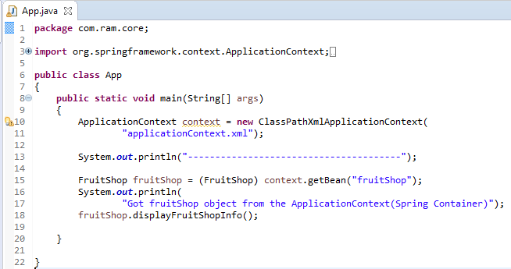
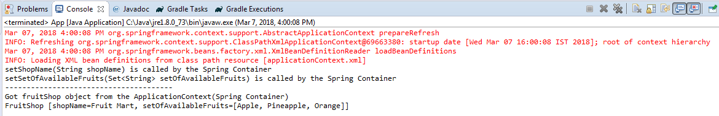
<util:set> to create a concrete Set Collection class (HashSet and TreeSet)

